Slide 1
superstore New Dashboard
File created on: 8/13/2023 10:47:04 AM

Slide 2
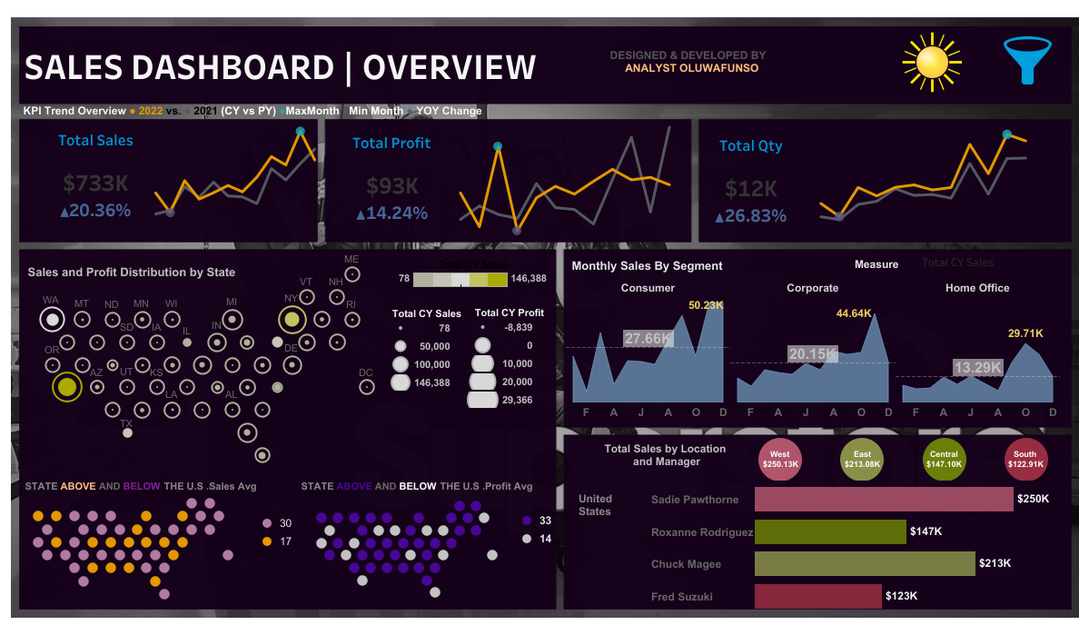

Slide 3
